Slide 1
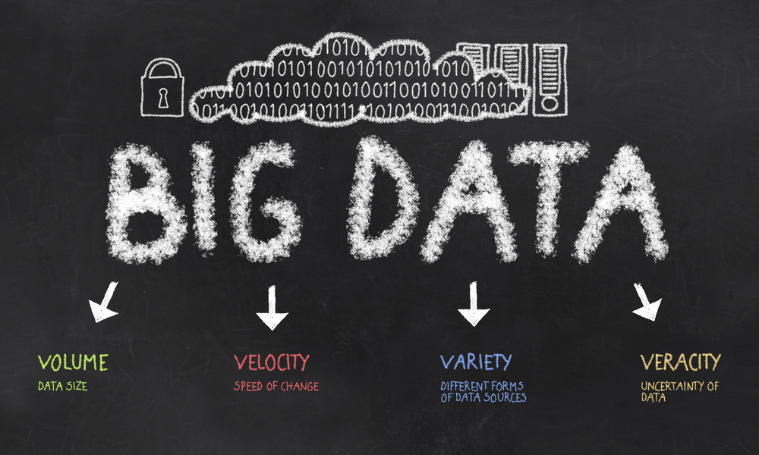

Slide 2






To get a better understanding of what Big Data is, it is often described using Five Vs:
Variety
Veracity
Value

Slide 3
We see increasing volumes of data, that grow at exponential rates:
Volume refers to the vast amounts of data generated every second. We are not talking Terabytes but Zettabytes or Brontobytes. If we take all the data generated in the world between the beginning of time and 2008, the same amount of data will soon be generated every minute. This makes most data sets too large to store and analyse using traditional database technology. New big data tools use distributed systems so that we can store and analyse data across databases that are dotted around anywhere in the world.
Variety
Veracity
Value

Slide 4
We see increasing velocity (or speed) at which data changes, travels or increases
Velocity refers to the speed at which new data is generated and the speed at which data moves around. Just think of social media messages going viral in seconds. Technology allows us now to analyse the data while it is being generated (sometimes referred to as in-memory analytics), without ever putting it into databases.
Variety
Veracity
Value

Slide 5
We see increasing variety of data types:
Variety refers to the different types of data we can now use. In the past we only focused on structured data that neatly fitted into tables or relational databases, such as financial data. In fact, 80% of the world’s data is unstructured (text, images, video, voice, etc.) With big data technology we can now analyse and bring together data of different types such as messages, social media conversations, photos, sensor data, video or voice recordings.
Variety
Veracity
Value

Slide 6
We see increasing veracity (or accuracy) of data
Veracity refers to the messiness or trustworthiness of the data. With many forms of big data quality and accuracy are less controllable (just think of Twitter posts with hash tags, abbreviations, typos and colloquial speech as well as the reliability and accuracy of content) but technology now allows us to work with this type of data.
Variety
Veracity
Value

Slide 7
Value – The most important V of all!
Then there is another V to take into account when looking at Big Data: Value!
Having access to big data is no good unless we can turn it into value.
Companies are starting to generate amazing value from their big data. See some examples here.
Variety
Veracity
Value

Slide 8

We currently only see the beginnings of a transformation into a big data economy.
Any business that doesn’t seriously consider the implications of Big Data runs the risk of being left behind.
Here at the Advanced Performance Institute we help companies understand and leverage Big Data.
© 2014 Advanced Performance Institute, BWMC Ltd. All rights reserved.

Slide 9

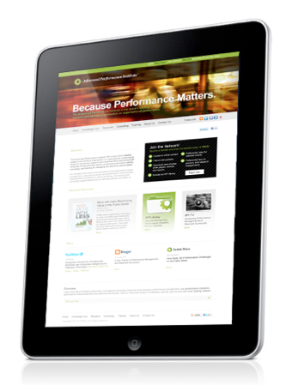
About
This overview was put together by
Bernard Marr,
Founder and CEO of the Advanced Performance Institute.
Bernard Mar is a bestselling business author, keynote speaker, strategic performance consultant, and analytics, KPI & Big Data guru.
Read Bernard’s blogs:
LinkedIn Influencer Blog
Big Data Guru Blog
Connect with Bernard on:
LinkedIn
Twitter
Facebook
Google+
YouTube
Advanced Performance Institute
For more articles, white papers, case studies and much more visit the Advanced Performance Institute Knowledge Hub

